Slide 1
Unit IV - Introducing Extract, Transformation & Load
Course Outcome: Explain various components and working of ETL Systems

Slide 2
Round up Requirements
Business Needs
-information required by business users to make decisions
-business needs drive choice of data sources and their transformation
-maintain dialog amoung ETL team, data architect and modelers,business analyst and business users.
NOTE: You should maintain a list of the key performance indicators (KPIs) uncovered during the business requirements defi nition that the project intends to support, as well as the drill-down and drill-across targets required when a business user needs to investigate “why?” a KPI changed.

Slide 3
Compliance
-ensure reported numbers are accurate, complete
-saving archived copies of data sources and subsequent data staging
-providing proof of complete transaction flow that changed data
-supplying proof of security of data copies over time.
Note: List those data inputs and data transformation steps for which you must maintain the “chain of custody” showing and proving that final reports were derived from the original data delivered from your data sources

Slide 4
Data Quality
-Three important demands
-First Data is important for users to function
-Second data is distributed
-Third increase in demands for compliance
Security
-which data to publish and to whom
-seek advice from security manager
NOTE
You should list those data elements whose quality is known to be unacceptable, and list whether an agreement has been reached with the source systems to correct the data before extraction.
List those data elements discovered during
data profi ling, which will be continuously monitored and fl agged as part of the ETL process.

Slide 5
Security
During the requirements roundup, the DW/BI team should seek clear guidance from senior management as to what aspects of the DW/BI system carry extra security sensitivity.
NOTE: You should expand the compliance checklist to encompass known security and privacy requirements.

Slide 6
Data Integration
-it makes all systems work together seamlessly
Serious data integration must take place amoung transaction systems
-takes form of conforming dimensions and conforming facts in DW
-CDs means setting common dimensional attributes across business processes
-CAs means making agreements on common business metrics
NOTE : You should use the bus matrix of business processes to generate a priority list for conforming dimensions (columns of the bus matrix).
Annotate each row of the bus matrix with whether there is a clear executive demand for the business process to participate in the integration process, and whether the ETL team responsible for that business process has agreed

Slide 7
Data Latency
-how quickly source data must be delivered to business users
-it affect ETL architecture
-good algorithm, parallelization and good hardware can speed up batch oriented data
-ETL must convert batch processing to stream processing if latency is most urgent
NOTE You should list all legitimate and well-vetted business demands for data that must be provided on a daily basis, on a many times per day basis, within a few seconds, or instantaneously.
Annotate each demand with whether the business community understands the data quality trade-of s associated with their particular choice.

Slide 8
Archiving
-staging data after each major activity in ETL process
-archive all the staged data on permanent storage device
-each staged /archived data should have metadata describing origin and processing steps that produced data
User delivery Interfaces
-should work closely with modeling team to deliver data in a format which is easy to understand, well structured and easy to retrieve
NOTE You should list the data sources and intermediate data steps that will be
archived, together with retention policies, and compliance, security, and privacy
constraints.

Slide 9
BI Delivery Interface
The ETL team and data modelers need to closely work with the BI application developers to determine the exact requirements for the data handoff .
Each BI tool has certain sensitivities that should be avoided and certain features that can be exploited if the physical data is in the right format.
NOTE You should list all fact and dimension tables that will be directly exposed to your BI tools. This should come directly from the dimensional model specification.
List all OLAP cubes and special database structures required by BI tools.
List all known indexes andaggregations you have agreed to build to support BI
performance.

Slide 10
Available skills
-ETL design should be based on resources and skills available
-decide to buy vendors package or hand code
-technical issues and license cost
NOTE You should inventory your department’s operating system, ETL tool, scripting language, programming language, SQL, DBMS, and OLAP skills so you understand how exposed you are to a shortage or loss of these skills.
List those skills required to support your current systems and your likely future systems

Slide 11
Legacy Licenses
You should list your legacy operating system, ETL tool, scripting language, programming language, SQL, DBMS, and OLAP licenses and whether their exclusive use is mandated or merely recommended.

Slide 12
The 34 Subsystems of ETL
Extracting. Gathering raw data from the source systems and usually writing it to disk in the ETL environment before any significant restructuring of the data takes place. Subsystems 1 through 3 support the extracting process.
■ Cleaning and conforming. Sending source data through a series of processing steps in the ETL system to improve the quality of the data received from the source, and merging data from two or more sources to create and enforce conformed dimensions and conformed metrics. Subsystems 4 through 8 describe the architecture required to support the cleaning and conforming processes.
■ Delivering. Physically structuring and loading the data into the presentation server’s target dimensional models. Subsystems 9 through 21 provide the capabilities for delivering the data to the presentation server.
■ Managing. Managing the related systems and processes of the ETL environment in a coherent manner. Subsystems 22 through 34 describe the components needed to support the ongoing management of the ETL system.

Slide 13
1. Extracting Data from Source Systems
Data Profiling: Analyzes source data to determine its suitability.
Change Data Capture: Identifies and captures changes in the source data.
Extract System: Extracts data from source systems.
2. Cleaning and Conforming Data
Data Cleansing System: Implements data quality processes.
Error Event Tracking: Captures and tracks data quality errors.
Audit Dimension Creation: Attaches metadata to fact tables.
Deduplication: Eliminates redundant data entries.
Conforming Dimensions: Ensures consistency across dimensions.

Slide 14
3. Delivering Data to the Presentation Server
Surrogate Key Management: Manages surrogate keys for dimensions.
Slowly Changing Dimensions: Handles changes in dimension data over time.
Fact Table Load: Loads data into fact tables.
Dimension Table Load: Loads data into dimension tables.
Aggregate Fact Table Load: Loads data into aggregate fact tables.
Fact Table Indexing: Indexes fact tables for performance.
Dimension Table Indexing: Indexes dimension tables for performance.

Slide 15
3. Delivering Data to the Presentation Server
Fact Table Partitioning: Partitions fact tables for manageability.
Dimension Table Partitioning: Partitions dimension tables for manageability.
Fact Table Compression: Compresses fact tables to save space.
Dimension Table Compression: Compresses dimension tables to save space.
Fact Table Archiving: Archives old fact table data.
Dimension Table Archiving: Archives old dimension table data.
Fact Table Backup: Backs up fact table data.
Dimension Table Backup: Backs up dimension table data.

Slide 16
4. Managing the ETL Environment
Job Scheduling: Schedules ETL jobs.
Job Monitoring: Monitors ETL job execution.
Job Logging: Logs ETL job execution details.
Job Recovery: Recovers from ETL job failures.
Job Performance Tuning: Tunes ETL job performance.
Metadata Management: Manages metadata for ETL processes.
Security Management: Ensures security of ETL processes.
Data Lineage Tracking: Tracks data lineage through ETL processes.
Data Quality Monitoring: Monitors data quality continuously.
Data Governance: Ensures compliance with data governance policies.
ETL Documentation: Documents ETL processes and procedures.

Slide 17
Subsystem 1: Data Profiling
Data profiling helps you understand the structure, content, and quality of your data before you start the extraction, transformation, and loading processes.
Key Components of Data Profiling:
Structure Analysis
  Schema Analysis: Verify that the data conforms to the expected schema (e.g., correct data types, field lengths).
  Metadata Analysis: Review metadata to understand data definitions and relationships.
Content Analysis
  Value Distribution: Analyze the distribution of values within each column to identify patterns, outliers, and anomalies.
  Frequency Analysis: Determine the frequency of distinct values to identify common and rare values.

Slide 18
Subsystem 1: Data Profiling
Quality Analysis
  Completeness: Check for missing or null values.
  Uniqueness: Identify duplicate records.
  Consistency: Ensure data is consistent across different sources and within the dataset itself.
  Accuracy: Validate data against known standards or reference data.
Relationship Analysis
  Foreign Key Analysis: Verify the integrity of relationships between tables.
  Dependency Analysis: Identify dependencies between different data elements.

Slide 19
Subsystem 1: Data Profiling
Tools and Techniques:
Profiling Tools: Use tools like Apache Griffin, Talend, Informatica, or custom SQL scripts to perform data profiling.
Visualization: Employ data visualization techniques to better understand data distributions and anomalies.
Automated Profiling: Implement automated profiling processes to regularly monitor data quality.
Benefits of Data Profiling:
Improved Data Quality: Identify and address data quality issues early.
Better Decision Making: Gain insights into data that inform transformation rules and business decisions.
Efficient ETL Process: Streamline the ETL process by understanding data characteristics upfront.

Slide 20
Subsystem 2: Change Data Capture System
Isolate the changed source data to allow selective processing rather than a complete refresh.
Capture all changes (deletions, edits, and insertions) made to the source data, including changes made through nonstandard interfaces.
Tag changed data with reason codes to distinguish error corrections from true updates
Support compliance tracking with additional metadata.
Perform the CDC step as early as possible, preferably before a bulk datatransfer to the data warehouse.

Slide 21
Change Detection
  Log-Based CDC: Monitors transaction logs to detect changes. This method is efficient and minimally invasive.
  Trigger-Based CDC: Uses database triggers to capture changes as they happen. This can be more immediate but may introduce overhead.
Change Capture
  Change Tables: Captured changes are stored in change tables that mirror the structure of the source tables¹.
  Metadata Storage: Along with the data changes, metadata such as timestamps and transaction IDs are also stored.

Slide 22
3. Error Handling and Recovery
  Logging and Alerts: Implement robust logging and alerting mechanisms to handle errors and ensure data integrity.
  Retry Mechanisms: Ensure that failed data captures can be retried and successfully processed.
4. Data Integration
  ETL/ELT Processes: CDC integrates seamlessly with ETL (Extract, Transform, Load) and ELT (Extract, Load, Transform) processes, enabling efficient data movement and transformation.
  Data Warehousing: Ensures that data warehouses are kept in sync with source systems.

Slide 23
Benefits of CDC:
Real-Time Data Integration: Keeps target systems in sync with source systems in real-time.
Reduced Latency: Minimizes the delay between data changes and their reflection in target systems.
Improved Data Quality: Ensures that data is consistent and up-to-date across all systems.

Slide 24
Cleaning and Conforming Data
■ Declare a high-level commitment to a data quality culture.
■ Drive process reengineering at the executive level.
■ Spend money to improve the data entry environment.
■ Spend money to improve application integration.
■ Spend money to change how processes work.
■ Promote end-to-end team awareness.
■ Promote interdepartmental cooperation.
■ Publicly celebrate data quality excellence.
■ Continuously measure and improve data quality.

Slide 25
Subsystem 3: Extract System
The Extract System is a crucial component of ETL (Extract, Transform, Load) processes. It is responsible for extracting data from various sources, including databases, files, APIs, and other systems.
Key Requirements for an Extract System:
Source System Connectivity:
  Connectors: Develop or utilize connectors to connect to different data sources.
  Compatibility: Ensure compatibility with various database platforms, file formats, and APIs.
Data Extraction Methods:
  Batch Extraction: Extract data in batches for large datasets.
  Incremental Extraction: Extract only the changes made to data since the last extraction.
  Real-Time Extraction: Extract data as it becomes available.

Slide 26
3. Data Extraction Scheduling:
  Schedule Definition: Define the frequency of data extraction (e.g., daily, hourly, real-time).
  Scheduling Tools: Use scheduling tools to automate the extraction process.
4. Data Extraction Performance:
  Optimization: Optimize data extraction performance to minimize load on source systems.
  Parallel Processing: Consider parallel processing for large datasets.
5. Data Quality and Validation:
  Data Validation: Implement data validation checks to ensure data quality during extraction.
  Error Handling: Define procedures for handling errors and exceptions.

Slide 27
Data Extraction Logging:
  Logging: Log extraction activities for auditing and troubleshooting purposes.
Security and Access Control:
  Authentication and Authorization: Implement authentication and authorization mechanisms to control access to data sources.
  Data Encryption: Encrypt sensitive data during extraction.
Scalability:
  Scalability: Design the extract system to handle increasing data volumes and source systems.
  Horizontal Scaling: Consider horizontal scaling by adding more extract nodes.
Integration with ETL Process:
Integration: Integrate the extract system with the overall ETL process.
Data Delivery: Deliver extracted data to the transformation system.

Slide 28
Subsystem 4: Data Cleansing System
The Data Cleansing System is an essential component of ETL processes responsible for identifying and correcting errors, inconsistencies, and inaccuracies in data. It ensures data quality and consistency before loading data into the data warehouse.
Key Requirements for a Data Cleansing System:
Data Quality Assessment:
  Data Profiling: Analyze data characteristics to identify potential issues (e.g., missing values, outliers, duplicates).
  Data Quality Metrics: Define and measure data quality metrics (e.g., completeness, accuracy, consistency).

Slide 29
Data Cleansing Rules:
  Rule Definition: Define rules for identifying and correcting data errors (e.g., formatting, consistency, range checks).
  Rule Enforcement: Implement mechanisms to enforce cleansing rules.
Data Cleansing Techniques:
  Data Imputation: Fill in missing values with appropriate values.
  Data Standardization: Convert data to a consistent format.
  Data Correction: Correct errors and inconsistencies in data.
  Data Deduplication: Remove duplicate records.
  Data Normalization: Normalize data to improve data integrity.
Data Cleansing Automation:
  Automation: Automate the cleansing process as much as possible to improve efficiency.
  Rule-Based Automation: Use rule-based automation to apply cleansing rules consistently.

Slide 30
Data Cleansing Performance:
  Performance Optimization: Optimize cleansing processes for performance, especially for large datasets.
  Parallel Processing: Consider parallel processing to improve performance.
Data Quality Monitoring:
  Monitoring: Monitor data quality before and after cleansing to assess the effectiveness of the process.
  Feedback Loop: Implement a feedback loop to continuously improve cleansing rules.
Data Cleansing Documentation:
  Documentation: Document cleansing rules, techniques, and processes for future reference.
Integration with ETL Process:
  Integration: Integrate the cleansing system with the overall ETL process.
  Data Delivery: Deliver cleansed data to the transformation or loading systems.

Slide 31
Subsystem 5: Error Event Schema
The Error Event Schema is a critical component of an ETL system that defines the structure and content of error messages generated during the ETL process. It provides a standardized way to capture and report errors, facilitating troubleshooting and analysis.
Key Requirements for an Error Event Schema:
Error Classification:
  Error Types: Define different types of errors (e.g., extraction errors, transformation errors, loading errors).
  Error Severity: Assign severity levels to errors (e.g., critical, warning, informational).

Slide 32
Error Details:
  Error Message: Include a clear and concise error message describing the problem.
  Error Timestamp: Record the timestamp when the error occurred.
  Error Source: Specify the source of the error (e.g., data source, ETL component).
  Error Location: Provide information about the location of the error within the data (e.g., row number, column name).
  Error Context: Include relevant context to understand the error (e.g., input values, transformation steps).
Error Stack Trace:
  Stack Trace: Capture the stack trace to identify the exact location of the error in the code.

Slide 33
Error Handling Mechanisms:
  Error Logging: Log error events for analysis and troubleshooting.
  Error Notification: Send notifications to relevant stakeholders (e.g., administrators, developers).
  Error Recovery: Define strategies for recovering from errors (e.g., retrying failed operations, skipping records).
Error Reporting:
  Error Reporting Tools: Use error reporting tools to collect and analyze error data.
  Error Dashboards: Create dashboards to visualize error trends and patterns.

Slide 34
Error Analysis and Troubleshooting:
  Root Cause Analysis: Analyze error data to identify the root causes of problems.
  Troubleshooting Guidelines: Develop guidelines for troubleshooting common errors.
Error Prevention:
  Preventive Measures: Implement measures to prevent common errors (e.g., data validation, error handling).
Error Documentation:
  Documentation: Document error types, severity levels, and handling procedures.

Slide 35

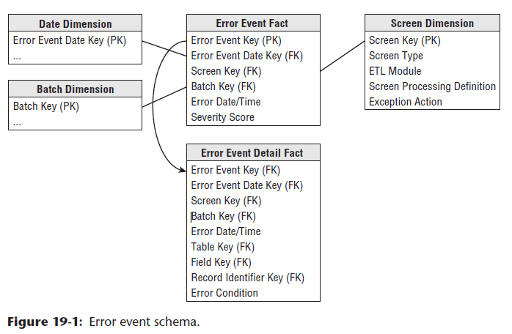

Slide 36
Subsystem 6: Audit Dimension Assembler
The Audit Dimension Assembler is a component within ETL processes that creates and maintains an audit dimension in a data warehouse. This dimension provides historical information about data changes, including when the changes occurred, who made them, and the reason for the changes.
Key Requirements for an Audit Dimension Assembler:
Audit Dimension Design:
  Dimension Attributes: Define the attributes of the audit dimension (e.g., audit key, change date, user ID, change reason, old value, new value).
  Granularity: Determine the desired granularity of the audit dimension (e.g., record level, field level).

Slide 37
Change Capture:
  Change Detection: Implement mechanisms to detect changes to data (e.g., triggers, CDC).
  Change Data Capture: Capture information about changes, including the old and new values.
Audit Data Assembly:
  Data Assembly: Assemble audit data into records for the audit dimension.
  Data Transformation: Apply necessary transformations to audit data (e.g., data type conversion, formatting).
Audit Data Loading:
  Data Loading: Load audit data into the audit dimension in the data warehouse.
  Incremental Loading: Implement incremental loading to efficiently capture changes.

Slide 38
Audit Data Retention:
  Retention Policy: Define a retention policy for audit data to manage storage costs and compliance requirements.
Audit Data Access Control:
  Access Controls: Implement access controls to restrict access to audit data.
Audit Data Integration:
  Integration: Integrate the audit dimension with other dimensions and facts in the data warehouse.
Audit Data Analysis:
  Analysis Tools: Provide tools for analyzing audit data to identify trends, anomalies, and security breaches.

Slide 39
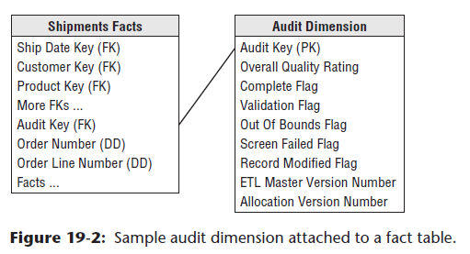

Slide 40
Subsystem 7: Deduplication System
The Deduplication System is a component within ETL processes that identifies and removes duplicate records from data. It helps to ensure data quality and consistency by eliminating redundant information.
Key Requirements for a Deduplication System:
Duplicate Identification:
  Duplicate Detection Algorithms: Implement algorithms to identify duplicate records based on specific criteria (e.g., unique identifiers, key fields).
  Fuzzy Matching: Consider fuzzy matching techniques for identifying records that are similar but not identical.
Deduplication Rules:
  Rule Definition: Define rules for determining if two records are duplicates.
  Rule Application: Apply deduplication rules to identify duplicate records.

Slide 41
Subsystem 8: Conforming System
The Conforming System is a component within ETL processes that ensures data consistency and adheres to defined standards or business rules. It transforms and standardizes data to a common format, making it suitable for analysis and integration with other systems.
Key Requirements for a Conforming System:
Conforming Rules:
  Rule Definition: Define rules for conforming data to specific standards or business requirements (e.g., data types, formats, values).
  Rule Enforcement: Implement mechanisms to enforce conforming rules.
Data Transformation:
  Transformation Logic: Develop transformation logic to convert data to the desired format (e.g., data type conversion, formatting, normalization).
  Data Enrichment: Add missing or derived data to enhance data value.
  Data Masking: Mask sensitive data to protect privacy.

Slide 42
Data Standardization:
  Standardization Guidelines: Define standardization guidelines for data elements (e.g., date formats, currency codes).
  Standardization Tools: Utilize standardization tools to automate the process.
Data Quality Checks:
  Data Validation: Validate data against conforming rules to ensure quality.
  Error Handling: Define procedures for handling errors and inconsistencies.
Conforming System Integration:
  Integration: Integrate the conforming system with the overall ETL process.
  Data Delivery: Deliver conformed data to subsequent ETL steps.
Conforming System Performance:
  Performance Optimization: Optimize conforming processes for performance.
Parallel Processing: Consider parallel processing for large datasets.
Conforming System Monitoring:
  Monitoring: Monitor the effectiveness of conforming processes.
Conforming System Documentation:
  Documentation: Document conforming rules, transformation logic, and processes.

Slide 43
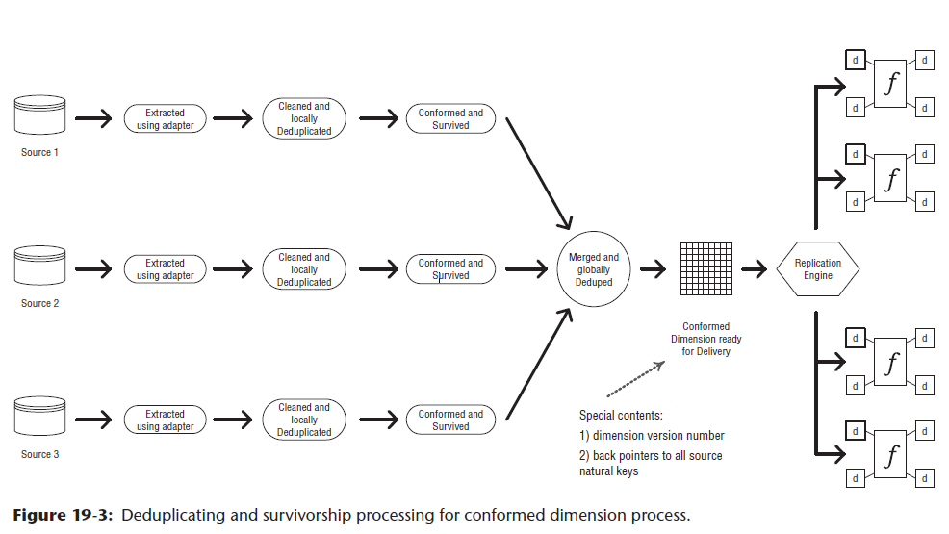

Slide 44
Subsystem 9: Slowly Changing Dimension Manager
The Slowly Changing Dimension Manager is a component within ETL processes that handles changes to dimensions over time. Dimensions are used to categorize and group facts in a data warehouse, and they often evolve over time due to changes in business rules or data requirements.
Key Requirements for a Slowly Changing Dimension Manager:
Dimension Type Identification:
  Type 1: Overwrite: Each change creates a new record.
  Type 2: Add New Row: Each change creates a new record with a new effective date.
  Type 3: Add New Attribute: Changes are stored in a separate history table.

Slide 45
Change Detection:
  Change Detection Mechanisms: Use triggers, CDC, or other methods to detect changes to dimension data.
Change Data Capture:
  Data Capture: Capture information about changes, including old and new values.
Dimension Update Logic:
  Update Logic: Implement logic to update dimensions based on the chosen dimension type.
  Effective Date Management: Manage effective dates for Type 2 dimensions.
  History Table Management: Manage history tables for Type 3 dimensions.
Dimension Data Loading:
  Data Loading: Load updated dimension data into the data warehouse.
  Incremental Loading: Implement incremental loading to efficiently update dimensions.
Dimension Data Consistency:
  Consistency Checks: Ensure consistency between dimensions and facts.
Dimension Data Retention:
  Retention Policy: Define a retention policy for historical data.
Dimension Data Access Control:
  Access Controls: Implement ac

Slide 46
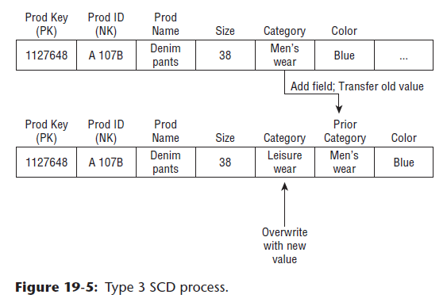

Slide 47
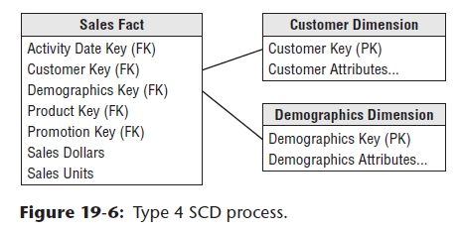
Type 4: Add Mini-Dimension

Slide 48
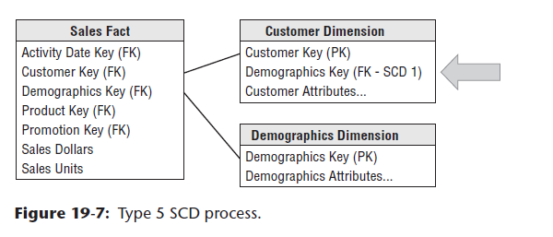
Type 5: Add Mini-Dimension and Type 1 Outrigger

Slide 49
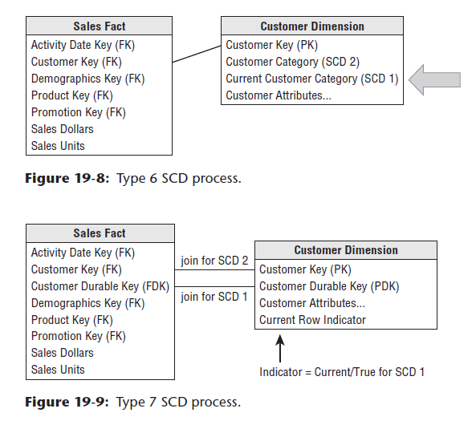
Type 6: Add Type 1 Attributes to Type 2 Dimension
Type 7: Dual Type 1 and Type 2 Dimensions

Slide 50
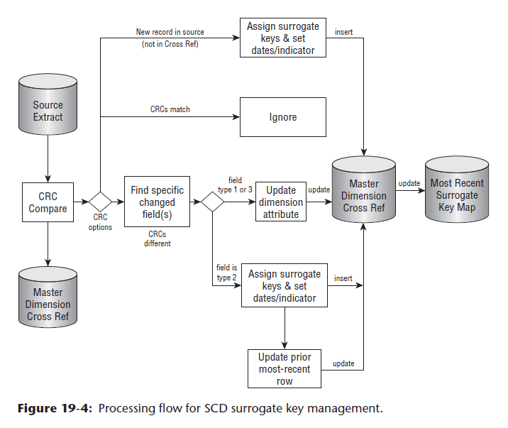

Slide 51
Subsystem 10: Surrogate Key Generator
The Surrogate Key Generator is a component within ETL processes that creates unique identifiers (surrogate keys) for records in a data warehouse. These surrogate keys are used to replace natural keys (e.g., customer ID, product ID) to improve performance, maintain data consistency, and simplify data relationships.
Key Requirements for a Surrogate Key Generator:
Surrogate Key Generation Algorithm:
  Algorithm Selection: Choose a suitable algorithm for generating unique surrogate keys (e.g., sequence generator, UUID generator).
  Algorithm Implementation: Implement the selected algorithm efficiently.

Slide 52
Subsystem 11: Hierarchy Manager
The Hierarchy Manager is a component within ETL processes that handles hierarchical relationships between data elements. It manages and maintains hierarchies, such as organizational hierarchies, product hierarchies, or geographical hierarchies.
Key Requirements for a Hierarchy Manager:
Hierarchy Definition:
  Hierarchy Structure: Define the structure of the hierarchy, including levels, parent-child relationships, and attributes.
  Hierarchy Rules: Establish rules for managing hierarchies (e.g., level restrictions, attribute constraints).

Slide 53
Subsystem 12: Special Dimensions Manager
The Special Dimensions Manager is a component within ETL processes that handles specific types of dimensions that require specialized management techniques. These dimensions may have unique characteristics or constraints that make them different from standard dimensions.
Key Requirements for a Special Dimensions Manager:
Dimension Type Identification:
  Special Dimension Types: Identify the types of special dimensions (e.g., slowly changing dimensions, degenerate dimensions, snowflake dimensions)

Slide 54
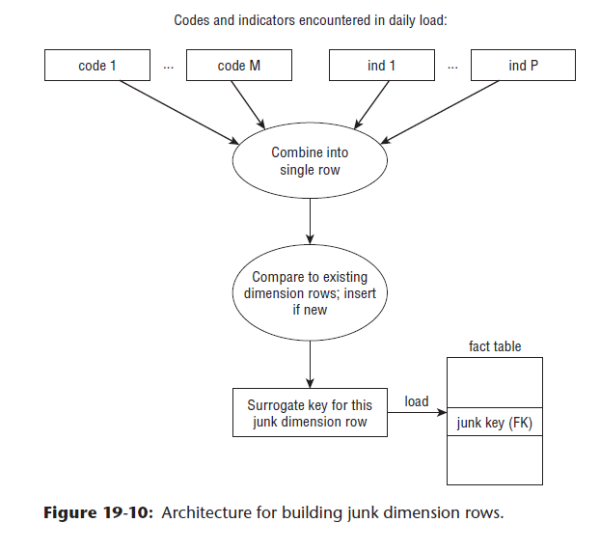

Slide 55
Subsystem 13: Fact Table Builders
The Fact Table Builders are components within ETL processes that assemble fact tables, which store quantitative measurements (facts) associated with dimensions. Fact tables provide the analytical foundation of a data warehouse.
Key Requirements for Fact Table Builders:
Fact Table Design:
  Fact Table Structure: Define the structure of fact tables, including primary key, foreign keys to dimensions, and measures.
  Granularity: Determine the desired granularity of fact tables (e.g., transaction level, daily, monthly).

Slide 56
Fact Table Types: Consider different types of fact tables (e.g., additive, semi-additive, non-additive).
Fact Table Denormalization: Determine if denormalization is appropriate to improve query performance.
Fact Table Partitioning: Consider partitioning fact tables for performance and manageability.

Slide 57
Subsystem 14: Surrogate Key Pipeline
The Surrogate Key Pipeline is a component within ETL processes that manages the generation, assignment, and maintenance of surrogate keys. Surrogate keys are unique identifiers assigned to records in a data warehouse to improve performance, maintain data consistency, and simplify data relationships.
Key Requirements for a Surrogate Key Pipeline:
Surrogate Key Generation:
  Generation Algorithm: Select a suitable algorithm for generating unique surrogate keys (e.g., sequence generator, UUID generator).
  Generation Logic: Implement logic to generate surrogate keys based on the selected algorithm.
Surrogate Key Assignment:
  Assignment Strategy: Determine how surrogate keys will be assigned to records (e.g., during data extraction, loading, or transformation).
  Assignment Logic: Implement logic to assign surrogate keys to records.

Slide 58
Subsystem 14: Surrogate Key Pipeline
Surrogate Key Management:
  Key Management: Manage the pool of available surrogate keys.
  Key Reuse: Define rules for reusing surrogate keys (if applicable).
Surrogate Key Consistency:
  Consistency Checks: Ensure consistency between surrogate keys and natural keys.
Surrogate Key Performance:
  Performance Optimization: Optimize surrogate key generation and assignment for performance.
Surrogate Key Integration:
  Integration: Integrate the surrogate key pipeline with the overall ETL process.
Surrogate Key Documentation:
  Documentation: Document the surrogate key generation algorithm, assignment strategy, and management rules.

Slide 59
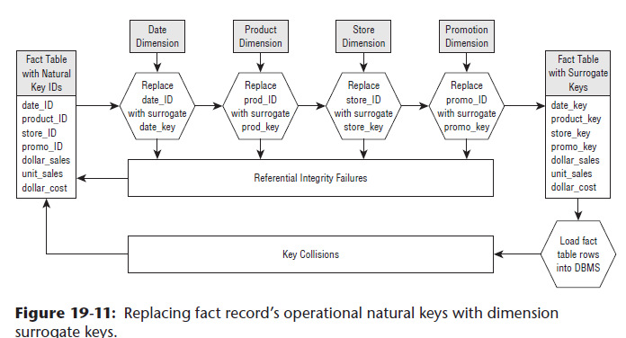

Slide 60
ETL Data Structure
1. Tables
Relational Tables: In databases, tables store data in rows and columns. During the ETL process, tables are often used to store intermediate results, staging data, or final processed data.
Staging Tables: Temporary tables where data is loaded before transformation. They often store raw data extracted from source systems.
2. Data Frames
Pandas DataFrames: In Python-based ETL processes, Pandas DataFrames are used for data manipulation and transformation. They provide a flexible way to handle structured data.
Spark DataFrames: In Apache Spark, Spark DataFrames are used for distributed data processing and transformation. They are similar to Pandas DataFrames but optimized for large-scale data processing.

Slide 61
ETL Data Structure
3. Queues
Message Queues: Systems like RabbitMQ or Apache Kafka use message queues to handle the flow of data between different components in an ETL pipeline. They help in managing data ingestion and ensure reliable data transfer.
4. Data Warehouses and Data Lakes
Data Warehouses: Specialized databases designed for query and analysis, where structured data is loaded after transformation. Examples include Amazon Redshift and Google BigQuery.
Data Lakes: Storage systems that hold vast amounts of raw data in its native format. They are used for storing unstructured or semi-structured data. Examples include AWS S3 and Hadoop HDFS.

Slide 62
ETL Data Structure
5. Hash Tables
Hash Tables: Used for quick lookups and to manage key-value pairs. They are useful in deduplication and fast data retrieval tasks during the transformation phase.
6. Graphs
Graphs: Represent data in nodes and edges. In ETL processes, graphs can be used to model complex relationships between data entities and are useful in scenarios involving social network analysis or hierarchical data.
7. Trees
Hierarchical Trees: Useful for representing hierarchical data structures, such as organizational charts or directory structures. Trees are often used in data transformations that involve hierarchical data.

Slide 63
ETL Data Structure
8. Sets
Sets: Collections of unique elements. They are used in ETL processes for tasks like removing duplicates and performing set operations (e.g., union, intersection).
9. Buffers
Buffers: Temporary storage areas used to hold data during the ETL process. Buffers help in managing data flows and ensuring smooth data transfers between different stages of the ETL pipeline.
10. Indexing Structures
Indexes: Improve query performance by providing fast access to rows in a table. In ETL, indexes can speed up data retrieval operations, especially during the transformation phase.

Slide 64
ETL Data Structure
11. Metadata Repositories
Metadata Repositories: Store information about the data, such as data lineage, definitions, and transformation rules. They are essential for understanding data origins and transformations.
12. Logs and Audit Trails
Logs: Track the ETL process, including data extraction, transformation, and loading activities. They help in troubleshooting and monitoring the ETL pipeline.

Slide 65
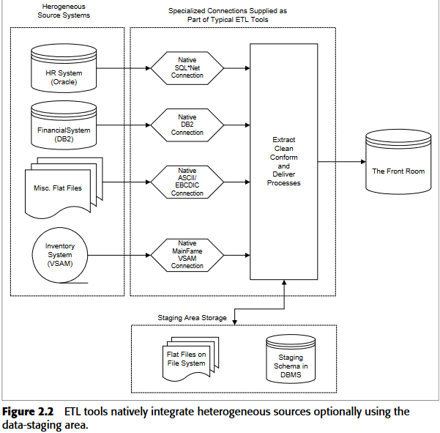

Slide 66
Extracting - Designing Logical Before Physical
1. Extract Phase
Identify Data Sources: Determine where the data will come from (databases, APIs, flat files, etc.).
Define Extraction Methods: Choose how data will be extracted (full extraction, incremental extraction, etc.).
Data Profiling: Analyze the data to understand its structure, quality, and relationships.

Slide 67
Extracting - Designing Logical Before Physical
2. Logical Design
Data Flow Diagrams: Create diagrams to visualize how data moves through the system.
Data Mapping: Define how data fields from the source map to the destination.
Transformation Rules: Specify the rules and logic for transforming data (e.g., data cleaning, aggregation).
Error Handling: Plan how to handle errors and exceptions during the ETL process.

Slide 68
Extracting - Designing Logical Before Physical
3. Physical Design
Choose ETL Tools: Select the tools and technologies for implementing the ETL process (e.g., Apache NiFi, Talend, Informatica).
Database Design: Design the schema for the staging area and the target data warehouse or data lake.
Performance Optimization: Plan for indexing, partitioning, and other optimizations to ensure efficient data processing.
Security Measures: Implement security protocols to protect data during extraction, transformation, and loading.

Slide 69
Extracting - Designing Logical Before Physical
4. Load Phase
Loading Strategy: Decide on the loading strategy (batch loading, real-time loading).
Data Validation: Ensure data integrity and consistency after loading.
Monitoring and Maintenance: Set up monitoring to track ETL performance and handle maintenance tasks.

Slide 70
Have a plan
Identify data source candidates.
Analyze source systems with a data-profiling tool.
Receive walk-though of data lineage and business rules
Receive walk-through of data warehouse data model.
Validate calculations and formulas

Slide 71
Components of the Logical Data Map
1. Entities
Entities represent distinct objects or concepts within the data model. For example, in a sales database, entities might include Customer, Order, and Product.
2. Attributes
Attributes are the specific details or characteristics of an entity. For instance, a Customer entity might have attributes like CustomerID, Name, Email, and PhoneNumber.
3. Relationships
Relationships define how entities are connected to each other. For example, a Customer might have a relationship with an Order, indicating that the customer has placed that order.
4. Business Rules
These are the rules and constraints that govern the data. They ensure data integrity and consistency. For example, a business rule might state that an Order must have at least one Product.

Slide 72
Components of the Logical Data Map
5. Data Types
Data types specify the kind of data that can be stored in each attribute, such as integer, string, date, or boolean. This helps in maintaining data accuracy and integrity.
6. Data Flow
This represents how data moves from one entity to another, including any transformations that occur along the way. It helps in visualizing the entire ETL process.
7. Metadata
Metadata provides additional information about the data, such as its source, format, and any transformations applied. It helps in tracking and managing data throughout the ETL process.
8. Error Handling
This includes mechanisms for detecting, logging, and handling errors that occur during data extraction, transformation, or loading. It ensures data quality and reliability.

Slide 73
Building the Logical Data Map
The data discovery phase
  Collecting and Documenting Source Systems
  Keeping Track of the Source Systems
    Subject area
    Interface name
    Business name
    Priority
    Department/Business use
    Business owner
    Technical Owner
    DBMS
    Production server/OS
    Daily users.
    DB size.
    DB complexity
    # Transactions per day

Slide 74
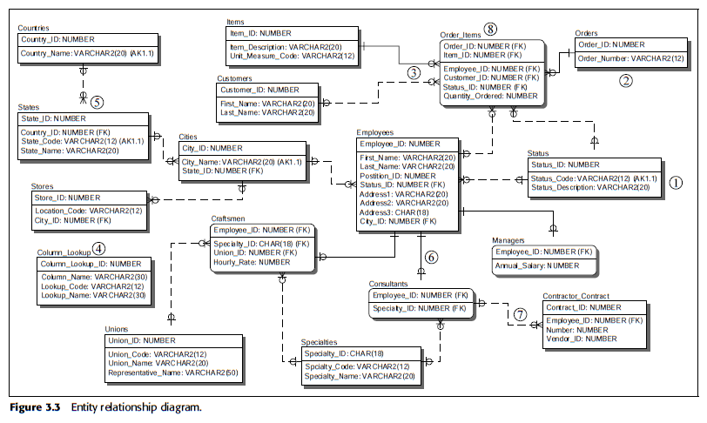
Building the Logical Data Map
The data discovery phase
  Determining the System-of-Record
  Analyzing the Source System: Using Findings from Data Profiling

Slide 75
Building the Logical Data Map
The data discovery phase
  Determining the System-of-Record
  Analyzing the Source System: Using Findings from Data Profiling
  Data Content Analysis
  Collecting Business Rules in the ETL Process
  Integrating Heterogeneous Data Sources
    Identify the source systems
    Understand the source systems (data profiling).
    Create record matching logic
    Establish survivorship rules.
    Establish nonkey attribute business rules
    Load conformed dimension

Slide 76
Building the Logical Data Map
The Challenge of Extracting from Disparate Platforms
1. Data Format Inconsistencies:
Different File Formats: Data may be stored in various formats like CSV, JSON, XML, or proprietary formats, requiring specific parsing techniques.
Varying Structures: Even within the same file format, data structures can differ, making it difficult to extract consistent information.
Encoding Issues: Different character encodings can lead to data corruption or misinterpretation.
2. API Limitations:
Authentication and Authorization: Accessing data through APIs often requires authentication and authorization, which can be complex and vary across platforms.
Rate Limits: Many APIs impose rate limits to prevent abuse, which can slow down extraction processes.
Versioning: API changes can break existing extraction scripts, requiring updates.

Slide 77
Building the Logical Data Map
The Challenge of Extracting from Disparate Platforms
3. Platform-Specific Challenges:
Proprietary Data Storage: Some platforms store data in proprietary formats that are not easily accessible or compatible with standard tools.
Security Restrictions: Strict security measures can limit access to data or require additional approvals.
Data Governance Policies: Different platforms may have varying data governance policies, affecting extraction processes.
4. Data Quality Issues:
Missing or Inconsistent Data: Data may be incomplete or contain inconsistencies, making it difficult to extract reliable information.
Data Integrity: Ensuring data integrity during extraction is crucial to prevent errors and inconsistencies.

Slide 78
Building the Logical Data Map
The Challenge of Extracting from Disparate Platforms
5. Technical Complexity:
Scripting and Programming: Extracting data often requires scripting or programming skills to interact with APIs or parse different data formats.
Tool Selection: Choosing the right tools or libraries for extraction can be challenging, depending on the specific platform and data format.
Error Handling: Implementing robust error handling mechanisms is essential to deal with unexpected issues during extraction.
6. Scalability and Performance:
Large Datasets: Extracting large datasets can be time-consuming and resource-intensive.
Performance Optimization: Optimizing extraction processes to improve performance and scalability is important, especially for frequently updated data.

Slide 79
Part 3: Extracting Changed Data
Extracting changed data is a common task in data management, particularly when dealing with large datasets that are frequently updated. This involves identifying and extracting only the records that have been modified since the last extraction.
Techniques for Extracting Changed Data
Timestamp or Versioning:
  Timestamp: If the data includes a timestamp field, you can extract records where the timestamp has been updated since the last extraction.
  Versioning: If the data has a versioning system, you can extract records with a higher version number than the last extraction.

Slide 80
Part 3: Extracting Changed Data
Change Data Capture (CDC):
  Dedicated CDC Tools: Use specialized CDC tools that capture and track changes to data in real-time.
  Database Triggers: Implement triggers on tables to log changes and extract them later.
  ETL Tools with CDC Functionality: Some ETL tools have built-in CDC capabilities.
Incremental Loading:
  ETL Processes: Configure ETL processes to extract only new or updated records based on a specific criteria (e.g., timestamp, version, or primary key).
  Database-Specific Features: Utilize database-specific features like incremental loading or change data capture to optimize the extraction process.
Hashing or Checksums:
  Hashing: Calculate a hash value for each record and compare it to the hash value from the last extraction. If the hash values differ, the record has changed.
  Checksums: Similar to hashing, checksums can be used to verify data integrity and identify changes.

Slide 81
Hashing or Checksums:
  Hashing: Calculate a hash value for each record and compare it to the hash value from the last extraction. If the hash values differ, the record has changed.
  Checksums: Similar to hashing, checksums can be used to verify data integrity and identify changes.

Slide 82
Considerations for Extracting Changed Data
Performance: For large datasets, consider using efficient techniques like CDC or incremental loading to minimize extraction time.
Data Consistency: Ensure that the extraction process maintains data consistency and avoids duplicates or missing data.
Error Handling: Implement robust error handling mechanisms to deal with potential issues during the extraction process.
Data Quality: Verify the quality of the extracted data to ensure accuracy and reliability.
Scalability: If the dataset is expected to grow significantly, choose a technique that can scale to handle larger volumes of data.

Slide 83
By effectively extracting changed data, you can:
Reduce data transfer volume.
Improve data processing efficiency.
Ensure data synchronization between systems.
Optimize data warehouse updates.

Slide 84
Building the Logical Data Map
1. Gather Requirements
Objective: Understand the data needs and objectives.
Stakeholder Interviews: Meet with stakeholders to understand their data requirements, including sources, transformations, and end-user needs.
Business Requirements: Document what the business needs from the ETL process, such as reports, analytics, or operational data.
Technical Requirements: Identify technical constraints and requirements, such as data volume, frequency of updates, and performance criteria.
2. Identify and Document Data Sources
Objective: Catalog all data sources that will feed into the ETL process.
List Sources: Identify all systems, databases, files, APIs, and external sources.
Source Details: Document the structure of each source, including tables, columns, data types, and relationships.
Access Methods: Describe how data will be accessed from each source (e.g., SQL queries, REST APIs, file reads).

Slide 85
Building the Logical Data Map
3. Define Extraction Points
Objective: Specify where and how data will be extracted.
Extraction Methods: Outline methods for data extraction, such as batch processing or real-time streaming.
Extracted Data Elements: Identify which data elements (tables, fields) are needed from each source.
Frequency and Timing: Define how often data will be extracted (e.g., hourly, daily).
4. Design Staging Areas
Objective: Create temporary storage solutions for raw data.
Staging Tables/Files: Design the schema for staging tables or files where raw data will be initially loaded.
Data Loading Procedures: Specify the process for loading data into staging areas, including any initial validation checks.
Data Retention: Define how long data will be kept in staging areas before further processing.

Slide 86
Building the Logical Data Map
5. Develop Transformation Rules
Objective: Specify how data will be transformed from its raw form to the desired format.
Transformation Logic: Define the rules and procedures for cleaning, aggregating, and enriching data.
Mapping Rules: Create detailed mappings from source fields to target fields, including any calculations or derivations.
Validation Rules: Set rules for validating data during transformation, such as consistency checks and data integrity rules.
6. Map Data Integration Points
Objective: Illustrate how data from different sources will be integrated.
Integration Points: Identify where data from multiple sources will be joined or merged.
Integration Logic: Document how data will be integrated, including join conditions, merging rules, and conflict resolution strategies.

Slide 87
Building the Logical Data Map
7. Design Target Data Structures
Objective: Define how and where transformed data will be stored.
Target Schema: Design the schema for final data storage, such as data warehouses, data marts, or data lakes.
Storage Requirements: Specify storage requirements, including table structures, indexing, and partitioning.
Loading Procedures: Define how transformed data will be loaded into the target structures.
8. Create Data Flow Diagrams
Objective: Visualize the flow of data through the ETL process.
Flow Diagrams: Develop diagrams that illustrate the movement of data from sources through staging and transformation to the final target.
Sequence of Operations: Show the sequence of ETL operations and data transformations.
Dependencies: Illustrate data dependencies and relationships.

Slide 88
Building the Logical Data Map
9. Incorporate Metadata
Objective: Document the metadata associated with the ETL process.
Metadata Documentation: Include data definitions, transformation rules, and mappings.
Metadata Repositories: Set up a repository for managing and storing metadata, including data lineage and data cataloging.
10. Define Data Quality and Security Measures
Objective: Ensure data quality and security throughout the ETL process.
Data Quality Rules: Define rules for data accuracy, completeness, and consistency.
Error Handling: Document procedures for error detection, logging, and resolution.
Data Security: Specify security measures, including encryption, access controls, and compliance with data privacy regulations.

Slide 89
Building the Logical Data Map
11. Plan for Performance Optimization
Objective: Ensure that the ETL process performs efficiently.
Optimization Techniques: Identify strategies for optimizing data extraction, transformation, and loading, such as parallel processing, indexing, and data partitioning.
Performance Monitoring: Define metrics for monitoring ETL performance and set up procedures for tuning and improving performance.
12. Address End-User Requirements
Objective: Ensure that the final data structure meets the needs of end-users.
Reporting Needs: Document requirements for data reporting and analysis.
Data Accessibility: Design target structures to facilitate efficient querying and analysis.
User Feedback: Gather feedback from end-users to refine the Logical Data Map and ensure it meets their needs.

Slide 90
Building the Logical Data Map
13. Validate and Refine
Objective: Review and finalize the Logical Data Map.
Stakeholder Review: Present the map to stakeholders for review and feedback.
Refinement: Make necessary adjustments based on feedback and ensure alignment with requirements.
14. Document and Communicate
Objective: Create comprehensive documentation and share with relevant teams.
Documentation: Prepare detailed documentation of the Logical Data Map, including data flow diagrams, transformation rules, and metadata.
Communication: Share the map with data engineers, analysts, and other relevant stakeholders to ensure everyone understands the ETL process.

Slide 91
Example: ETL Process for a Retail Business
1. Extraction
Source Systems: Data is extracted from various sources such as:
  Sales Database: Contains transaction details.
  Customer Relationship Management (CRM) System: Holds customer information.
  Inventory System: Tracks product stock levels.
2. Logical Data Map Creation
Identify Entities:
  Customer: Attributes include CustomerID, Name, Email, Phone.
  Product: Attributes include ProductID, Name, Category, Price.
  Sales: Attributes include SaleID, CustomerID, ProductID, Date, Quantity, TotalAmount.

Slide 92
Example: ETL Process for a Retail Business
Define Relationships:
  A Customer can make multiple Sales.
  A Product can be part of multiple Sales.
Specify Attributes:
  Customer: CustomerID (Primary Key), Name, Email, Phone.
  Product: ProductID (Primary Key), Name, Category, Price.
  Sales: SaleID (Primary Key), CustomerID (Foreign Key), ProductID (Foreign Key), Date, Quantity, TotalAmount.

Slide 93
Cleaning and Conforming
Part 1: Design Objectives
Part 2: Cleaning Deliverables
Part 3: Screens and Their Measurements
Part 4: Conforming Deliverables

Slide 94
Key Dimensions of Data Quality
Accuracy: Data is correct and free from errors.
Completeness: All necessary data elements are present and up-to-date.
Consistency: Data is consistent across different sources and formats.
Timeliness: Data is available when needed and reflects the current state.
Validity: Data adheres to predefined rules and constraints.
Uniqueness: Each data element has a unique identifier.
Relevance: Data is relevant to the intended purpose.
Understandability: Data is easily understood and interpreted.

Slide 95
Part 1: Design Objectives
Understand Your Key Constituencies
  Data Warehouse Manager
  Information-Quality Leader
  Dimension Manager
  Fact Table Provider
Balancing Conflicting Priorities
Formulate a Policy

Slide 96
Part 2: Cleaning Deliverables
Is data quality getting better or worse?
Which source systems generate the most/least data-quality issues?
Are there interesting patterns or trends revealed in scrutinizing the
data-quality issues over time?
Is there any correlation observable between data-quality levels and
the performance of the organization as a whole?
Perhaps the data warehouse manager also asks:
Which of my data-quality screens consume the most/least time in
my ETL window?
Are there data-quality screens that can be retired because the types of
issues that they uncover no longer appear in our data?

Slide 97
Part 2: Cleaning Deliverables
Data Profiling Deliverable
Good data-profiling analysis takes the form of a specific metadata repository describing:
  Schema definitions
  Business objects
  Domains
  Data sources
  Table definitions
  Synonyms
  Data rules
  Value rules
  Issues that need to be addressed

Slide 98
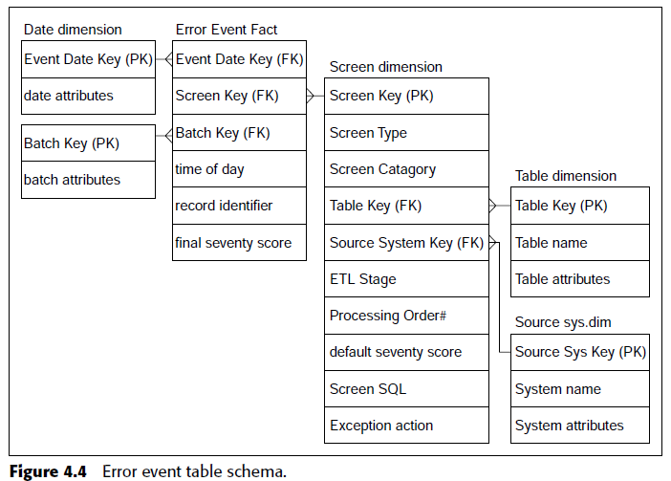
Part 2: Cleaning Deliverables
Cleaning Deliverable #1: Error Event Table

Slide 99
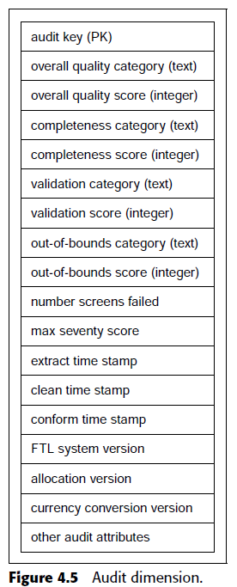
Part 2: Cleaning Deliverables
Cleaning Deliverable #2: Audit Dimension

Slide 100
Part 3: Screens and Their Measurements
Anomaly Detection Phase
Types of Enforcement
It is useful to divide the various kinds of data-quality checks into four broad
categories:
Column property enforcement
Structure enforcement
Data enforcement
Value enforcement

Slide 101
Part 3: Screens and Their Measurements
Anomaly Detection Phase
Types of Enforcement
Column Property Enforcement
Column property enforcement ensures that incoming data contains expected
values from the providing system’s perspective. Useful column
property enforcement checks include screens for:
Null values in required columns
Numeric values that fall outside of expected high and low ranges
Columns whose lengths are unexpectedly short or long
Columns that contain values outside of discrete valid value sets
Adherence to a required pattern or member of a set of patterns
Hits against a list of known wrong values where list of acceptable
values is too long
Spell-checker rejects

Slide 102
Part 3: Screens and Their Measurements
Anomaly Detection Phase
Types of Enforcement
Structure Enforcement
Whereas column property enforcement focuses on individual fields, structure
enforcement focuses on the relationship of columns to each other

Slide 103
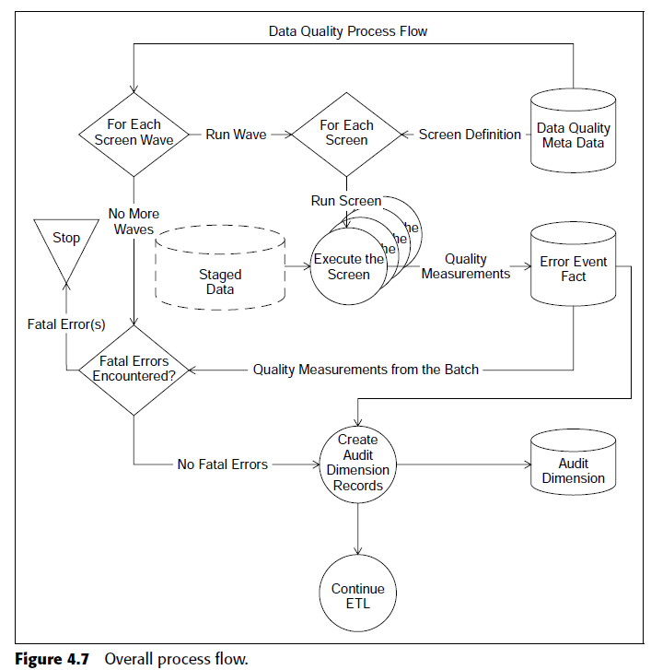
Measurements Driving Screen Design
Overall Process Flow

Slide 104
Part 4: Conforming Deliverables
three-step process for building conformed dimensions and facts:
Standardizing
Matching and deduplication
Surviving

Slide 105
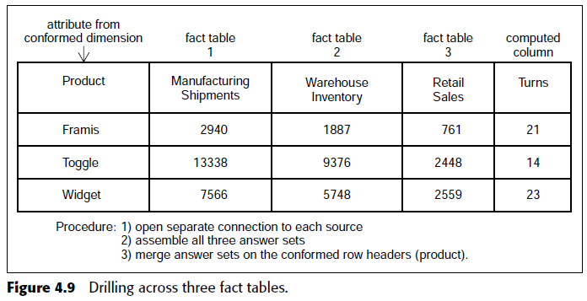
Part 4: Conforming Deliverables
Conformed Dimensions
  A conformed dimension means the same thing with every possible fact table to which it can be joined.

Slide 106
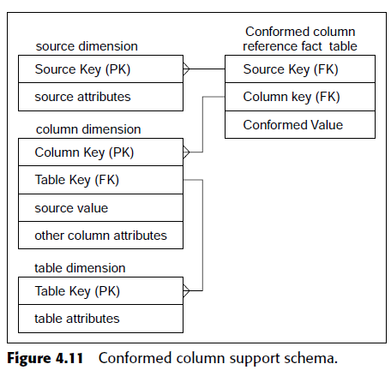
Part 4: Conforming Deliverables
Conformed Facts
Conformed facts can be directly compared and can participate in mathematical expressions such as sums or ratios.
Implementing the Conforming Modules

Slide 107
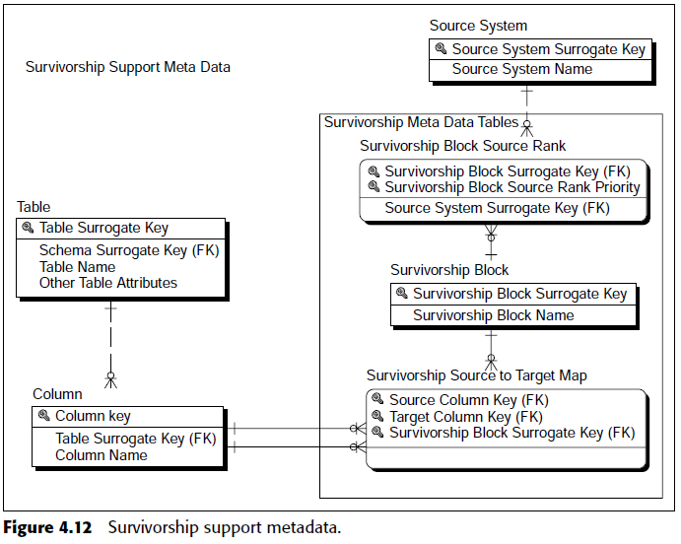
Part 4: Conforming Deliverables
Matching Drives Deduplication
Matching, or deduplication, involves the elimination of duplicate standardized records.
Surviving: Final Step of Conforming
Survivorship refers to the process of distilling a set of matched (deduplicated) records into a unified image that combines the highest-quality column values from each of the matched records to build conformed dimension records.
Delivering
Delivering is the final essential ETL step.

Slide 108
Delivering Data for Presentation
ETL and Delivering Data for Presentation: A Powerful Combination
ETL (Extract, Transform, Load) plays a crucial role in preparing data for effective presentation. By cleaning, transforming, and organizing data, ETL processes can ensure that the information delivered is accurate, relevant, and visually appealing.

Slide 109
Cleaning and Conforming
1. ETL Cleaning
ETL cleaning involves various processes to correct and improve the quality of the data extracted from source systems. This stage addresses issues like missing values, inaccuracies, and inconsistencies. Key cleaning tasks include:
1.1. Data Validation
Purpose: Verify that data meets predefined criteria or rules.
Examples: Ensuring that numeric fields contain only numbers, dates are valid, and email addresses have correct formats.
1.2. Handling Missing Values
Methods:
  Imputation: Fill missing values with statistical measures (mean, median) or estimated values.
  Deletion: Remove records with missing values if they are not critical.
  Flagging: Mark missing values for further review or special processing.

Slide 110
1.3. Removing Duplicates
Purpose: Eliminate duplicate records that may have been introduced during data extraction.
Methods:
  Exact Match: Identify and remove duplicate records with identical values.
  Fuzzy Matching: Use algorithms to find and merge records that are similar but not exactly the same.
1.4. Data Standardization
Purpose: Ensure data is in a consistent format.
Examples: Converting dates to a standard format (e.g., YYYY-MM-DD), standardizing address formats, and unifying case (e.g., uppercase for all text fields).
1.5. Data Correction
Purpose: Fix inaccuracies or errors in data.
Examples: Correcting misspelled names, updating outdated information, and rectifying incorrect values.
1.6. Outlier Detection and Handling
Purpose: Identify and address data points that deviate significantly from the norm.
Methods:
  Statistical Analysis: Use statistical methods to detect outliers.
  Business Rules: Apply predefined rules to identify unusual data.

Slide 111
ETL Conforming
2. ETL Conforming
ETL conforming focuses on ensuring that data from different sources is consistent and compatible with the target system. It aligns data to a common standard and integrates it into a unified view. Key conforming tasks include:
2.1. Data Integration
Purpose: Combine data from multiple sources into a coherent format.
Methods:
  Schema Integration: Align different schemas to a common schema.
  Data Merging: Combine data from various sources into a unified dataset.
2.2. Data Mapping
Purpose: Map source data fields to target data fields.
Examples: Matching source columns to target columns, translating field names, and aligning data types.

Slide 112
2.3. Data Aggregation
Purpose: Summarize or aggregate data from detailed records to a higher level of granularity.
Examples: Calculating total sales from individual transactions, summarizing daily data to monthly totals.
2.4. Data Normalization
Purpose: Adjust data to fit a common scale or standard.
Examples: Converting different currencies to a single currency, normalizing numerical values to a common range.
2.5. Data Enrichment
Purpose: Enhance data with additional information to improve its value.
Examples: Adding geographic information based on IP addresses, appending demographic details to customer records.
2.6. Data Consistency Checks
Purpose: Ensure that data is consistent across different sources and within the target system.
Examples: Verifying that corresponding records in different datasets match and that data adheres to consistency rules.

Slide 113
Best Practices for ETL Cleaning and Conforming
Automate Processes: Use ETL tools and scripts to automate cleaning and conforming tasks, reducing manual effort and errors.
Document Rules: Clearly document cleaning and conforming rules and procedures to ensure consistency and facilitate maintenance.
Validate Results: Regularly validate cleaned and conformed data to ensure accuracy and compliance with requirements.
Monitor Data Quality: Implement monitoring and reporting mechanisms to continuously assess and improve data quality.
Tools for ETL Cleaning and Conforming
Data Integration Tools: Tools like Informatica, Talend, and Microsoft SSIS provide built-in features for data cleaning and conforming.
Data Quality Tools: Tools such as IBM InfoSphere QualityStage, SAS Data Quality, and Data Ladder offer specialized functionalities for data cleaning and standardization.
Data Profiling Tools: Use tools like Apache Griffin and Talend Data Quality for profiling and understanding data quality issues.

Slide 114
Key Roles of ETL in Data Presentation:
Data Quality:
  Cleaning: Removing errors, inconsistencies, and duplicates to ensure data accuracy.
  Standardization: Formatting data consistently for easy interpretation and analysis.
Data Transformation:
  Aggregation: Summarizing data into meaningful aggregates (e.g., averages, totals).
  Calculations: Performing calculations to derive new insights from the data.
  Formatting: Preparing data for visualization in specific formats (e.g., CSV, JSON).

Slide 115
Key Roles of ETL in Data Presentation:
Data Integration:
  Combining Sources: Merging data from multiple sources to provide a comprehensive view.
  Harmonization: Resolving inconsistencies and conflicts between different datasets.
Data Governance:
  Metadata Management: Ensuring that data is well-documented and understood.
  Data Security: Protecting sensitive data and ensuring compliance with regulations.

Slide 116
ETL Tools and Data Visualization:
Many ETL tools offer built-in or integrated data visualization capabilities. This allows for seamless data preparation and presentation, saving time and effort. Some popular ETL tools with visualization features include:
Talend: Offers a wide range of data integration and visualization capabilities.
Informatica: Provides robust ETL and data warehousing solutions with visualization options.
SSIS (SQL Server Integration Services): A Microsoft tool that can be used for ETL and data visualization.

Slide 117
Best Practices for Using ETL for Data Presentation:
Define Clear Objectives: Clearly outline the goals of your presentation and ensure that the ETL process aligns with those objectives.
Choose Appropriate Visualization Techniques: Select visualizations that are appropriate for your data and audience (e.g., bar charts, line charts, pie charts).
Consider Data Storytelling: Use ETL to create a compelling narrative around your data, making it more engaging and memorable.
Test and Iterate: Continuously test and refine your ETL processes and visualizations to ensure they meet your presentation needs.

Slide 118
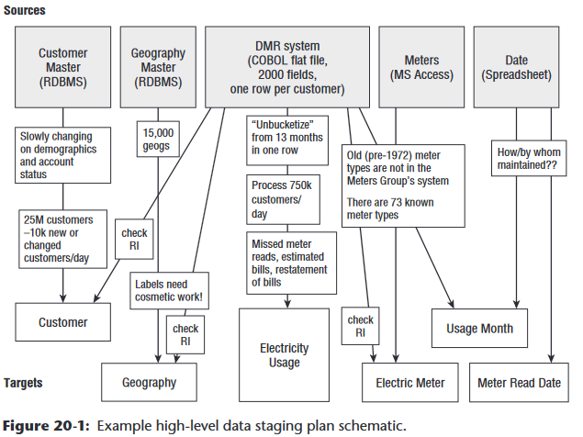
Develop the ETL Plan
Step 1: Draw the High-Level Plan

Slide 119
Step 2: Choose an ETL Tools
  Self-documentation that comes from using a graphical tool. A hand-coded system is usually an impenetrable mess of staging tables, SQL scripts, stored procedures, and operating system scripts.
  ■ Metadata foundation for all steps of the ETL process.
  ■ Version control for multi-developer environments and for backing out and restoring consistent versions.
  ■ Advanced transformation logic, such as fuzzy matching algorithms, integrated access to name and address deduplication routines, and data mining algorithms.
  ■ Improved system performance at a lower level of expertise. Relatively few SQL developers are truly expert on how to use the relational database to manipulate extremely large data volumes with excellent performance.
  ■ Sophisticated processing capabilities, including automatically parallelizing tasks, and automatic fail-over when a processing resource becomes unavailable.
  ■ One-step conversion of virtualized data transformation modules into their physical equivalents

Slide 120
Step 3: Develop Default Strategies
Extract from each major source system. At this point in the design process, you can determine the default method for extracting data from each source system. Will you normally push from the source system to a flat file, extract in a stream, use a tool to read the database logs, or another method? This decision can be modified on a table-by-table basis. If using SQL to access source system data, make sure the native data extractors are used rather than ODBC, if that’s an option.
■ Archive extracted and staged data. Extracted or staged data, before it’s been transformed, should be archived for at least a month. Some organizations permanently archive extracted and staged data.

Slide 121
Step 3: Develop Default Strategies
■ Police data quality for dimensions and particularly facts. Data quality must be monitored during the ETL process rather than waiting for business users to find data problems. Chapter 19 describes a comprehensive architecture for measuring and responding to data quality issues in ETL subsystems 4 through 8.
■ Manage changes to dimension attributes. In Chapter 19, we described the logic required to manage dimension attribute changes in ETL subsystem 9.

Slide 122
Step 3: Develop Default Strategies
■ Ensure the data warehouse and ETL system meet the system availability requirements. The first step to meeting availability requirements is to document them. You should document when each data source becomes available and block out high-level job sequencing.
■ Design the data auditing subsystem. Each row in the data warehouse tables should be tagged with auditing information that describes how the data entered the system.
■ Organize the ETL staging area. Most ETL systems stage the data at least once or twice during the ETL process. By staging, we mean the data will be written to disk for a later ETL step and for system recovery and archiving

Slide 123
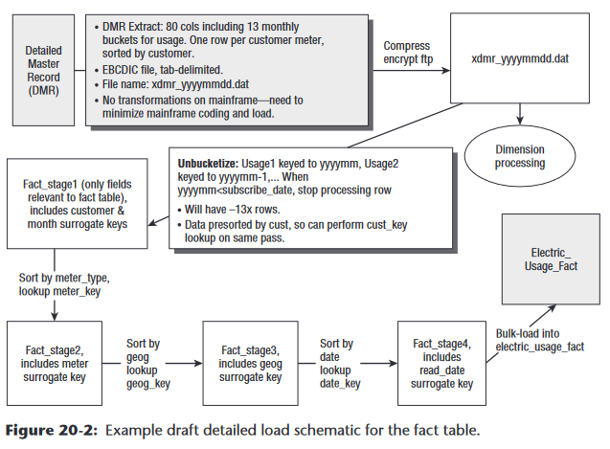
Step 4: Drill Down by Target Table
Ensure Clean Hierarchies
Develop Detailed Table Schematics

Slide 124
Develop the ETL Specification Document
Develop a Sandbox Source System

